Slide 1

SEXUALLY TRANSMITTED DISEASES IN TEENS
Student’s Name
Institutional Affiliations

Slide 2

Overview of the Risk Factors
Sexually transmitted diseases is prevalent in teenagers because the age group is sexually active.
Teenagers are psychologically vulnerable and sexually active.
Sexually transmitted diseases that face this age group include syphilis, gonorrhea, HIV, and genital herps
Sexually transmitted illness in teens are prevalent and research shows that almost have of teens will have STDs by age 24.
Curbing the problem in teens is not easy due to the adventurous nature of people in teenage and young adulthood age group
Notes:
Having multiple sexual partners is regarded as the most significant risk factor for STDs in teens.

Slide 3
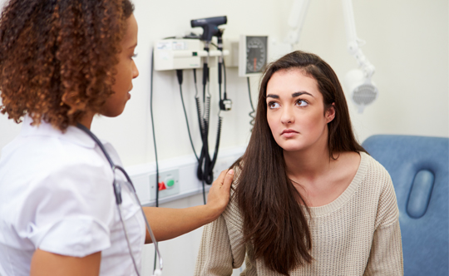
Contributing factors
The feeling of adulthood that brings about the urge to experiment sexual intercourses
Peer pressure for most teenagers who have already have sexual partners
Having unprotected sex (Do you use condoms? Have tests with a sexual partner before sex?_
Not taking tests before engaging is sex
Vulnerability of teenagers who are desperate to find belonging in certain groups
Notes:
Sexually transmitted diseases in teenagers are contributed by factors such as peer pressure and desire to find belonginess in particular group settings (Alimoradi, 2017). Most teenagers are pushed to having unprotected sex by those around them/ The vulnerability of teenagers as a result of desire to be accepted in peer groups in social settings such as schools, teenagers and home also contribute to STDs in teens.
…. Share any other factors that you think contribute to STDs in young adults and teens.

Slide 4
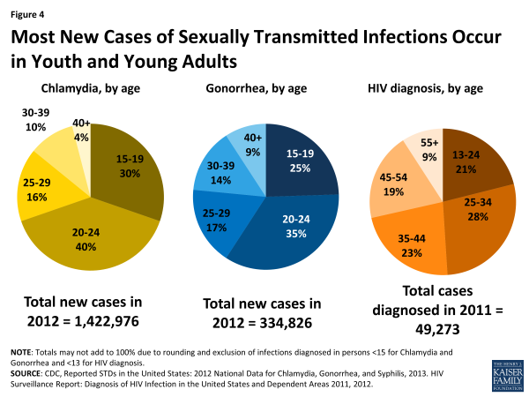
Prevalence of Sexually Transmitted Diseases in Teenagers
STDs are prevalent in teens within main cities and towns.
Prevalence of STDs is also high among people with less access to health education
Communities struggling with poverty experience high prevalence of STDs in teens
2 out of every 10 teenagers is reported to have STDs in major cities of the world according the WHO report of 2018.
4
Notes:
Prevalence of sexually transmitted diseases in teens is always high in areas that have little or no access to health education (Forhan, Gottlieb & Sternberg et al., 2009). Also exposure to digital media in major cities drives teenagers to experimentation with sexual matters leading to arise of infection in youth. Communities that experience high levels of poverty have recorded high rates of prevalence due to the vulnerability that such conditions expose to teenagers especially girls and young women.

Slide 5

Prevalence of STDs in Teenagers in various Territories of the US in 2017
The most prevalent STDs in teenagers in the United Sates of America are:
Chlamydia
Secondary and Primary Syphilis
Gonorrhea
Herps simplex Virus, and
Human papillomavirus
Image on the right hand side represents Gonorrhea infection in parts of the US in 2017.
5
Notes:
Have you had any of your teenage friend talking any of these diseases? Some have the diseases but do not know. Diagnosis is very important to know exactly what STD is ailing you. What do you think are some of the symptoms of these STD? Boils and purs around the genitals? Swollen genitals? Boils that are very painful? Wounds on the tang?

Slide 6


The role of a health care practitioner/Advocate Regarding STDs in Teenagers
Educate -Through seminars, community youth meetings and preparation and circulation of appropriate educational materials that enlighten youth on the disease
Diagnose-Carry out tests on teens to determine the illness being suffered
Refer-Refer youth to appropriate health facilities for diagnosis and treatment of the conditions being suffers. Also refer them for appropriate educational seminars about sexual life.
Treat- Prescribe and administer treatment and medication for various STDs.
Notes:
If you were a health care practitioner, what do you think your roles would be? ( Use this to create and interactive discussion between the presenter and the teenage audience).
A health advocate/practitioner plays 4 main important roles. Diagnosing, treating Referring and educating the society abouyt the various diseases

Slide 7
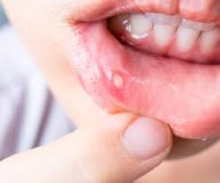
Ways of Identifying any STDs Diseases
To identify STDs, look out for the following general symptoms:
Sores and boil in private parts near genitals
Burning sensation when passing urine
Urinating blood
Pains in the abdominal areas
Sores on the tang and lips
Pain in the genitals when having sexual intercourse
Sensational itching in genitals
Notes:
Various STDs manifest themselves in different ways But general symptoms of most STDs rage from pains, sores and boils in the genitals and mouth areas (Sexual Health of Adolescents and Young Adults in the United States, 2014).
Discussion question for the teens: Which symptoms have you seen either in your self or someone in your life?

Slide 8
Addressing the Issue
Keeping one sexual partner
Testing for STIs before engaging in sex with a sexual partner to avoid being infected
Visiting a heath facility for advice and treatment
Attending teenage seminars about STDs and prevention of other diseases.
Avoiding rushing into relationships at a young age.
Notes:
Addressing issues of STD in teenagers has proved difficult for many health care departments not just in the US but in other countries as well. This is because most teens have never been involved in creating solutions for their problems related to STDs. As such, the best way to address the problem and prevalence of STDs in teens is to educate them on protecting themselves from scenarios that can expose them to infection.
What do you suggest to be the

Slide 9

Activity for the Audience Interaction
This activities will involve private meetings in groups of two.
The group must be of a male and female teenager. Interaction will last for at least 15 minutes
This activity will involve direct straight talk to each other.
During the activity, try to engage you partner in a talk over what they consider when choosing a sexual partner
Ask each other what you do before accept8ng to have a sexual intercourse with a partner already accepted.
What things can you accept to do with your partner before you to have a medical check up of STDs?

Slide 10
Help and Support Sources
Parents and other significant adults in a teens life
Guardians
Health facilities for diagnosis and treatment
Teenage counsellors such as religious leaders
Community Elders
Health practitioners in hospitals and also within the community.
Various webpages with information on STDs
Educational media programs such as TV shows about Teenager STDs
Notes:
Teenagers have a ;lot of avenues where they can get help from . Parents, health facilities, web pages with vast information on STDs and health counsellors in the society. Teenagers can also get help or information about how to protect themselves from STDs from available educational materials such as health flyers from health seminars and TV shows with programs about STDs.

Slide 11
References
Sexual Health of Adolescents and Young Adults in the United States (2014). Retrieved from https://www.kff.org/womens-health-policy/fact-sheet/sexual-health-of-adolescents-and-young-adults-in-the-united-states/
Forhan SE, Gottlieb SL, Sternberg MR, et al. (2009). Prevalence of sexually transmitted infections among female adolescents aged 14 to 19 in the United States. Pediatrics; 124(6):1505–1512.
Alimoradi, Z. (2017). Contributing factors to high-risk sexual behaviors among Iranian adolescent girls: A systematic review. International journal of community based nursing and midwifery, 5(1), 2.

Slide 12





THANK YOU
Name
Phone
Email
Website

